Slide 1
MEMORY MANAGEMENT
BSCS-IV

Slide 2
MEMORY MANAGEMENT
Memory management is the process of controlling and coordinating a computer's main memory.
It ensures that blocks of memory space are properly managed and allocated so the operating system (OS), applications and other running processes have the memory they need to carry out their operations.
This technique helps in keeping the track of each and every memory location, whether the memory location is allocated to some process or it is free.

Slide 3
MEMORY MANAGEMENT
Memory management technique decides which process will get memory at what time.
It also keeps the count of how much memory can be allocated to a process.
As it keeps the tracks of everything so whenever some memory gets freed or unallocated it updates the status correspondingly.

Slide 4
NEED FOR MEMORY MANAGEMENT
This technique helps in placing the programs in memory in such a way so that memory is utilized at its fullest extent.
This technique helps to protect different processes from each other so that they do not interfere with each other's operations.
It helps to allocate space to different application routines.
This technique allows you to check how much memory needs to be allocated to processes that decide which processor should get memory at what time.
It keeps the track of each memory location whether it is free or allocated.
This technique keeps the track of inventory whenever memory gets freed or unallocated and it will update the status accordingly.

Slide 5
MEMORY ALLOCATION
What is Memory allocation?
Memory allocation is a process by which computer programs are assigned memory or space.
Here, main memory is divided into two types of partitions
Low Memory – Operating system resides in this type of memory.
High Memory– User processes are held in high memory.

Slide 6
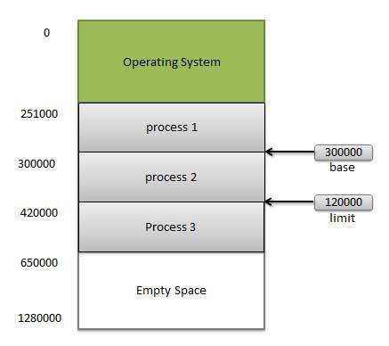
MEMORY ALLOCATION

Slide 7
SWAPING
Swapping is a method in which the process should be swapped temporarily from the main memory to the backing store.
It will be later brought back into the memory for continue execution.
Backing store is a hard disk or some other secondary storage device that should be big enough in order to accommodate copies of all memory images for all users.
It is also capable of offering direct access to these memory images.

Slide 8
SWAPING
A process needs to be in memory for execution.
But sometimes there is not enough main memory to hold all the currently active processes in a timesharing system.
So, the excess process is kept on disk and brought in to run dynamically.
Swapping is the process of bringing in each process in the main memory, running it for a while, and then putting it back to the disk.

Slide 9
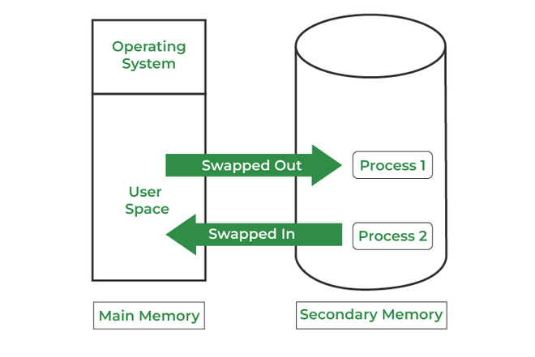
SWAPING

Slide 10
LOGICAL VS PHYSICAL ADDRESSES
The basic difference between Logical and physical address is that Logical address is generated by CPU in perspective of a program.
On the other hand, the physical address is a location that exists in the memory unit. The set of all logical addresses generated by CPU for a program is called Logical Address Space.

Slide 11
MEMORY ADDRESSES
Symbolic Addresses
- Addresses Used in a source code.
- Variable names, constants and instruction labels.
Relative Addresses / Relocatable
- Compiler converts symbolic address into relative address at the time of compilation.
Physical Addresses
- When a program is loaded is main memory, the loader generates these addresses.

Slide 12
ADDRESS BINDING
Address binding refers to the translation of provided virtual address spaces to actual physical / absolute memory address spaces to execute the program.
(The logical address does not exist physically in the memory, and therefore it is sometimes known as a virtual address. The physical address is a location in the memory unit. The logical address is used as a reference to access the physical address. The physical address cannot be accessed directly.)
There are different modes and sequences in which addresses are bound to their true value.

Slide 13
ADDRESS BINDING
There are mainly three types of an address binding in the OS.
Compile Time Address Binding
Load Time Address Binding
Execution Time or Dynamic Address Binding

Slide 14
COMPILE TIME ADDRESS BINDING
It occurs when it is known that where our program will reside in memory at the compile time.
The compiler is responsible for performing address binding, and the compiler interacts with the operating system to perform the address binding.
In other words, when a program is executed, it allocates memory to the system code of the computer.

Slide 15
LOAD TIME ADDRESS BINDING
When compiler does not know the memory location to store the program then it generates the relative or relocatable addresses of a program.
Loader translates these relocatable addresses into absolute or physical addresses

Slide 16
RUN TIME or DYNAMIC BINDING
When a process moves from one memory location to another memory location during execution.
Special hardware memory management unit (MMU) is used.
In MMU operating system maintains a relocation register where it keeps the base address of memory.
CPU generates the logical address then MMU combines with base address and then it becomes a physical address.
- Base address = 12000
- Logical address = 365
- Physical Addresses = 12365

Slide 17
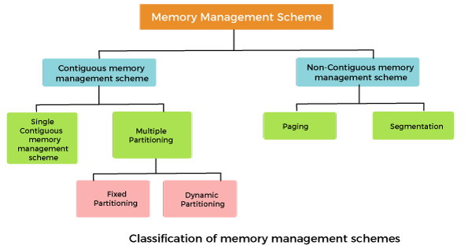
MEMORY MANAGEMENT TECHNIQUES

Slide 18
CONTIGUOUS MEMORY MANAGEMENT
In a Contiguous memory management scheme, each program occupies a single contiguous block of storage locations, i.e., a set of memory locations with consecutive addresses.
1. Single contiguous memory management schemes:
The Single contiguous memory management scheme is the simplest memory management scheme used in the earliest generation of computer systems.
In this scheme, the main memory is divided into two contiguous areas or partitions.
The operating systems reside permanently in one partition, generally at the lower memory, and the user process is loaded into the other partition.

Slide 19
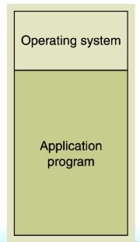
Contiguous memory management schemes:
1. Single contiguous memory management schemes:

Slide 20
Contiguous memory management schemes:
2. PARTITIONING or MULTIPLE PARTITIONING
The single Contiguous memory management scheme is inefficient as it limits computers to execute only one program at a time resulting in wastage in memory space and CPU time.
The problem of inefficient CPU use can be overcome using multiprogramming that allows more than one program to run concurrently.
To switch between two processes, the operating systems need to load both processes into the main memory. The operating system needs to divide the available main memory into multiple parts to load multiple processes into the main memory. Thus multiple processes can reside in the main memory simultaneously.

Slide 21
Contiguous memory management schemes:
2. PARTITIONING or MULTIPLE PARTITIONING
Fixed Partitioning
Variable/Dynamic Partitioning

Slide 22
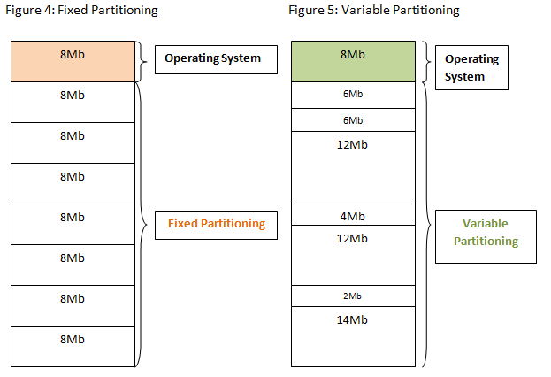
Contiguous memory management schemes:
2. PARTITIONING or MULTIPLE PARTITIONING

Slide 23
Contiguous memory management schemes:
2. PARTITIONING or MULTIPLE PARTITIONING
Fixed Partitioning:
The main memory is divided into several fixed-sized partitions in a fixed partition memory management scheme or static partitioning. These partitions can be of the same size or different sizes. Each partition can hold a single process.
The number of partitions determines the degree of multiprogramming, i.e., the maximum number of processes in memory. These partitions are made at the time of system generation and remain fixed after that.

Slide 24
Contiguous memory management schemes:
2. PARTITIONING or MULTIPLE PARTITIONING
Fixed Partitioning:
Advantages:
- Simple to implement.
- Easy to manage and design.
Disadvantages:
- This scheme suffers from internal fragmentation.
- The number of partitions is specified at the time of system generation.

Slide 25
Contiguous memory management schemes:
2. PARTITIONING or MULTIPLE PARTITIONING
Dynamic Partitioning:
- The dynamic partitioning was designed to overcome the problems of a fixed partitioning scheme.
- In a dynamic partitioning scheme, each process occupies only as much memory as they require when loaded for processing.
- Requested processes are allocated memory until the entire physical memory is exhausted or the remaining space is insufficient to hold the requesting process. In this scheme the partitions used are of variable size, and the number of partitions is not defined at the system generation time.

Slide 26
Contiguous memory management schemes:
2. PARTITIONING or MULTIPLE PARTITIONING
Dynamic Partitioning:
Advantages:
- Simple to implement.
- Easy to manage and design.
Disadvantages:
- This scheme also suffers from external fragmentation.
- The number of partitions is specified at the time of system segmentation.

Slide 27
Fragmentation
Fragmentation refers to an unwanted problem that occurs in the OS in which a process is unloaded and loaded from memory, and the free memory space gets fragmented.
The processes can not be assigned to the memory blocks because of their small size. Thus the memory blocks always stay unused.
Types:
1. Internal Fragmentation
2. External Fragmentation

Slide 28
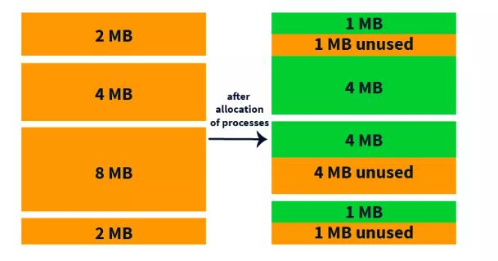
INTERNAL FRAGMENTATION

Slide 29
EXTERNAL FRAGMENTATION
External fragmentation occurs when total unused memory space is enough to answer all the allocation requests.
Here the memory is non-contiguous. Therefore, the memory has empty blocks scattered all over, which are insufficient to be allocated to other programs. Compaction is the solution for external fragmentation.

Slide 30
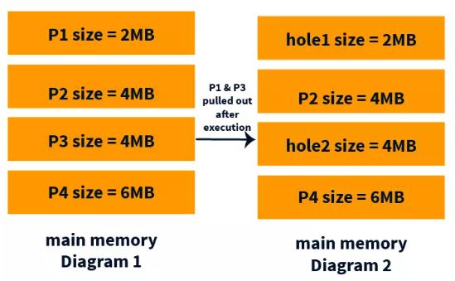
EXTERNAL FRAGMENTATION

Slide 31
METHODS TO ELIMINATE EXTERNAL FRAGMENTATION
COMPACTION
PAGING
SEGMENTATION

Slide 32
COMPACTION
External fragmentation can be reduced by compaction or shuffle memory contents to place all free memory together in one large block. To make compaction feasible, relocation should be dynamic.
In compaction, all the free partitions are made contiguous and all the loaded partitions are brought together. By applying this technique, we can store the bigger processes in the memory.
The free partitions are merged which can now be allocated according to the needs of new processes.

Slide 33
Non-Contiguous memory management schemes:
PAGING:
Paging is a technique that eliminates the requirements of contiguous allocation of main memory.
In this, the main memory is divided into fixed-size blocks of physical memory called frames.
The size of a frame should be kept the same as that of a page to maximize the main memory and avoid external fragmentation.

Slide 34
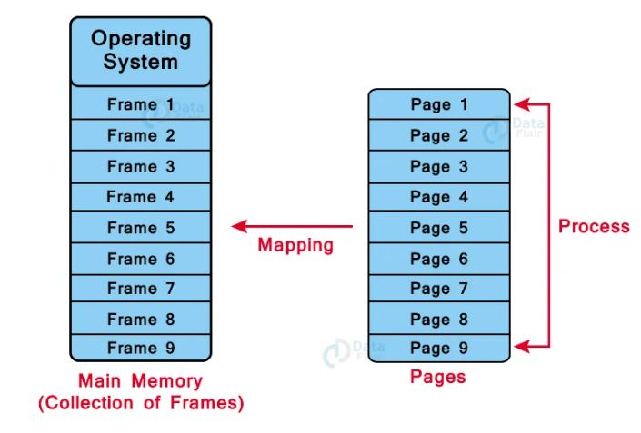
Non-Contiguous memory management schemes:
PAGING:

Slide 35
Non-Contiguous memory management schemes:
PAGING:
- Page Table:
A Page Table is the data structure used by a virtual memory system in a computer operating system to store the mapping between the virtual address and physical addresses.
The virtual address is also known as the Logical address and is generated by the CPU. While Physical address is the address that actually exists on memory.

Slide 36
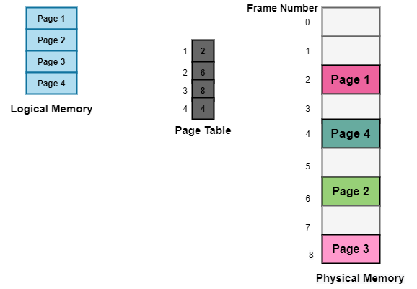
Non-Contiguous memory management schemes:
PAGING:
- Page Table:

Slide 37
Non-Contiguous memory management schemes:
PAGING:
Advantages of Paging in OS
The memory management algorithm is easy to use.
External Fragmentation is not required.
Swapping between equal-sized pages and page frames becomes easier.
Disadvantages of Paging in OS
Internal fragmentation.
Additional memory consumption by Page tables.
Memory reference overhead due to multi-level paging.

Slide 38
SEGMENTATION
Segmentation is similar to paging, except that the length of segments is variable and pages have a fixed size. The segment of a program comprises the program’s main function, data structures, utility functions, etc.
All this information about processes is maintained in the form of a segment map table by the OS. This table includes a list of segment numbers, free memory blocks, their sizes, and their memory locations in the main memory or virtual memory.

Slide 39
WHY SEGMENTATION
Paging may divide the same function into different pages and those pages may or may not be loaded at the same time into the memory.
It decreases the efficiency of the system.
It is better to have segmentation which divides the process into the segments.

Slide 40
SEGMENTAT TABLE
There is no simple relationship between logical addresses and physical addresses in segmentation. A table stores the information about all such segments and is called Segment Table.
Segment Table – It maps two-dimensional Logical address into one-dimensional Physical address. It’s each table entry has:
Base Address: It contains the starting physical address where the segments reside in memory.
Limit: It specifies the length of the segment.

Slide 41
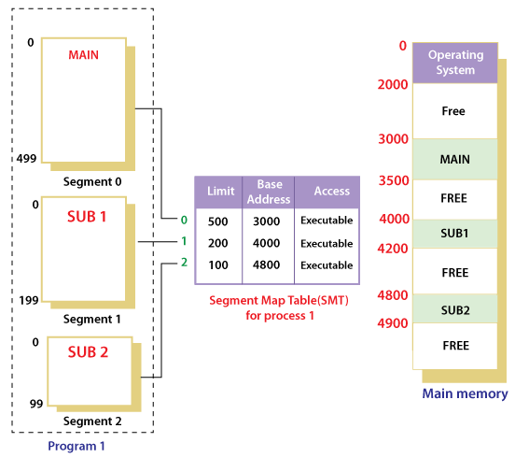
SEGMENTATION

Slide 42
SEGMENTATION
Advantages of Segmentation –
No Internal fragmentation.
Segment Table consumes less space in comparison to Page table in paging.
As a complete module is loaded all at once, segmentation improves CPU utilization.
The user’s perception of physical memory is quite similar to segmentation. Users can divide user programs into modules via segmentation. These modules are nothing more than the separate processes’ codes.
The user specifies the segment size, whereas in paging, the hardware determines the page size.
Segmentation is a method that can be used to segregate data from security operations.
Flexibility: Segmentation provides a higher degree of flexibility than paging. Segments can be of variable size, and processes can be designed to have multiple segments, allowing for more fine-grained memory allocation.
Sharing: Segmentation allows for sharing of memory segments between processes. This can be useful for inter-process communication or for sharing code libraries.
Protection: Segmentation provides a level of protection between segments, preventing one process from accessing or modifying another process’s memory segment. This can help increase the security and stability of the system.

Slide 43
SEGMENTATION
Disadvantage of Segmentation –
As processes are loaded and removed from the memory, the free memory space is broken into little pieces, causing External fragmentation.
Overhead is associated with keeping a segment table for each activity.
Due to the need for two memory accesses, one for the segment table and the other for main memory, access time to retrieve the instruction increases.
Fragmentation: As mentioned, segmentation can lead to external fragmentation as memory becomes divided into smaller segments. This can lead to wasted memory and decreased performance.
Overhead: The use of a segment table can increase overhead and reduce performance. Each segment table entry requires additional memory, and accessing the table to retrieve memory locations can increase the time needed for memory operations.
Complexity: Segmentation can be more complex to implement and manage than paging. In particular, managing multiple segments per process can be challenging, and the potential for segmentation faults can increase as a result.

Slide 44
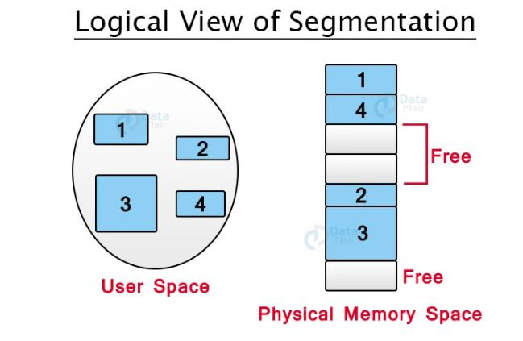
SEGMENTATION

Slide 45
SOLUTION
VIRTUAL MEMORY MANAGEMENT

